Slide 1
SQL Joins
Pradnya DAbhade

Slide 2
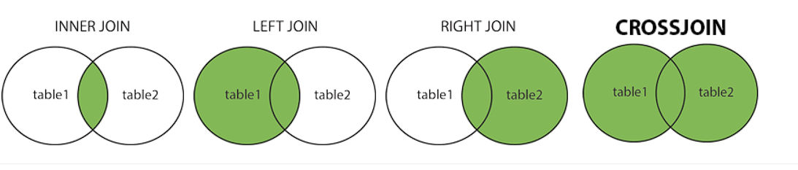
SQL Joins
MySQL JOINS are used with SELECT statement. It is used to retrieve data from multiple tables.
It is performed whenever you need to fetch records from two or more tables.
INNER JOIN: Returns records that have matching values in both tables
LEFT JOIN: Returns all records from the left table, and the matched records from the right table
RIGHT JOIN: Returns all records from the right table, and the matched records from the left table
CROSS JOIN: Returns all records from both tables

Slide 3
Inner Join | Inner join will always fetch the matching records
Left Join | Inner Join + fetch any additional records from left table which is not present in right table
Right Join | Inner Join + fetch any additional records from right table which is not present in left table
Full Join | Inner Join + fetch additional records from left table which is not present in right table + fetch additional records from right table which is not present in left table
Cross Join | Every record from left table matches with every other record in right table

Slide 4
 |  |  |  |  |  | Number of records
Matching | Table1 | Table2
2 | 1 | 1 |  |  | Inner Join | Left Join |  | Right Join |  | Full Join | Cross Join
2 | 1 | 1
2 | 1 | 2 |  |  | 8 | 8 +3=11 |  | 8+2=10 |  | 10+11=21 | 7*6=42
2 | 2 | 2
0 | 3 | 4
0 | 3 | null
0 | 3

Slide 5
Tables to create for joins example
Dept
Employee
Deptid | Deptname
1 | Sales
2 | HR
3 | Manufacturing
4 | Purchase
empid | first_name | last_name | email | deptid | salary | hiredate
1 | jyoti | chavan | jyoti@gmail.com | 2 | 25000.00 | 2023-01-01
2 | shraddha | chavan | shraddha@gmail.com | 2 | 25000.00 | 2023-11-01
3 | ram | charan | ram@gmail.com | 3 | 35000.00 | 2023-01-01
4 | ram | Yadav | ramyadav@gmail.com | 4 | 45000.00 | 2023-01-01

Slide 6
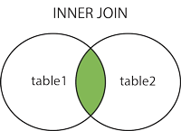
SQL Inner Join
SELECT column_name(s) FROM table1 INNER JOIN table2 ON table1.column_name = table2.column_name;
select * from employee
inner join dept on employee.deptid = dept.deptid;

Slide 7
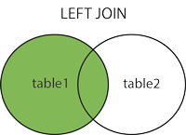
SQL Left Join
SELECT column_name(s) FROM table1 LEFT JOIN table2 ON table1.column_name = table2.column_name;
select * from employee
left join dept on employee.deptid = dept.deptid;

Slide 8
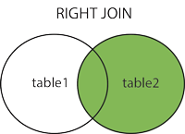
SQL Right Join
SELECT column_name(s) FROM table1 RIGHT JOIN table2 ON table1.column_name = table2.column_name;
select * from employee
right join dept on employee.deptid=dept.deptid;

Slide 9
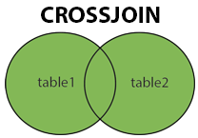
SQL Cross Join
SELECT column_name(s) FROM table1 CROSS JOIN table2;
select * from employee cross join dept;

Slide 10
Self Join example
select e1.first_name,
e1.last_name,
e2.deptid
from employee e1,
employee e2 where e1.deptid = e2.deptid;

Slide 11
Thank you
Pradnya DAbhade

